Slide 1
The mandatory content
Existence of God mandatory content.
Does God exist?
. What arguments/theories do religious people use to prove the existence of God?
. What evidence do religious people use to support these arguments/theories?
. What are the strengths and weaknesses of evidence/arguments/theories?
. What arguments/theories do non-religious people use to challenge the existence of God?
. What evidence do non-religious people use to support these arguments/theories?
. What are the strengths and weaknesses of evidence/arguments/theories?
. Can either religious or non-religious arguments/theories provide conclusive proof about the existence of God?

Slide 2

Learning Intention:
Today we are learning about the teleological argument from a philosophical understanding.
Success criteria:
By the end of the lesson I will:
Know the names of the 3 philosophers who support this theory.
Be clear about their ideas and understand their perspective.
Have also begun to learn about Humes viewpoint.

Slide 3
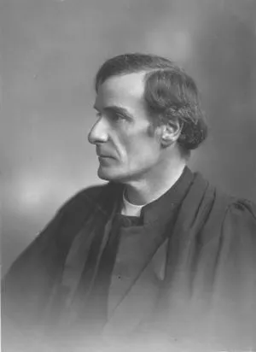
In agreement with the teleological argument
F R Tennant, (1866— 1957)
English philosophical theologian
Studied science at Cambridge, then became a minister.
He was also a lecturer in theology Cambridge.

Slide 4
Imagine this….
You've just checked into your hotel room for a weekend's getaway.
Thrilled by the fancy view, you immediately walk onto the room's balcony to take in the eighth floor view. Unfortunately, the guardrail gives way the instant you lean on it.
You plummet, falling head over heels toward the pavement of the street below.
You scream, but for some reason you don't feel the splat and splintering of every bone in your body. No, instead you find yourself immersed in an immense, soft cushion.
Of all the vehicles to fall into, you managed to hit an open trailer full of defective pillows from the local bedding factory.

Slide 5
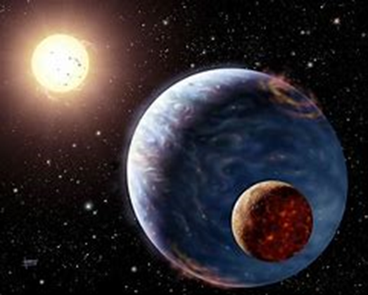
Why is it that conditions were just right for your survival?
This can be applied to apply the question to life on Earth.
Tennant called it the anthropic principle. It is focused on looking at the structure of the universe. He argues:
If even the slightest part of the universe were any different (e.g. distance of the planet earth from the sun) human life would not exist.
Certain complex conditions needed to be met in order for life to exist.
The universe was designed explicitly for the purpose of supporting human life. (KU)

Slide 6
He argues the entire universe was designed to produce human life one day.
This means the conditions at the moment of the Big Bang must have been precisely set so that, 10 billion years later, our star would form and, 5 billion years after that, our species would evolve on the third planet orbiting that star - Earth.
Supporters of this view point to many convenient facts about life on earth.
Our planet is 93 million miles from the sun, in the "Goldilocks Zone" where it's not too hot and not too cold - just right.
On top of that, we have the ozone layer that reflects harmful ultraviolet rays away from the planet.
We have the moon, which stabilises the earth's rotation (giving us regular seasons) but also produces tides (enabling sea creatures to evolve on land).
Further out in the solar system, the gas giants Jupiter and Saturn have powerful gravity and 'capture' asteroids and meteors that might otherwise hit our planet, wiping out life.

Slide 7
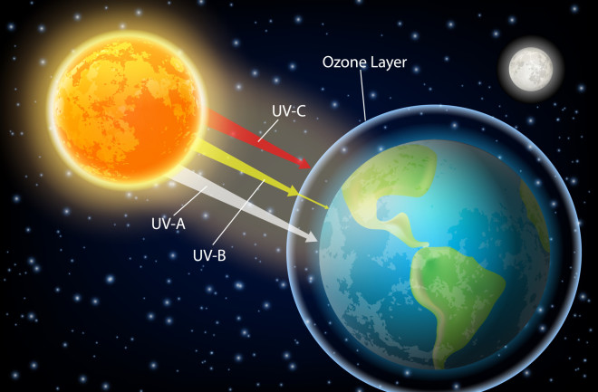
Arthur Brown looked at the ozone layer as further evidence of the anthropic principle.
What is the ozone layer?
The ozone layer is a thin part of the Earth's atmosphere that absorbs almost all of the sun's harmful ultraviolet light.

Slide 8

In 1943 Brown wrote a book called ‘Footprints of God’.
In it he explains that the ozone layer is the exact thickness to protect the earth from the suns harmful rays. This shows evidence of a plan and therefore a designer. (KU)

Slide 9
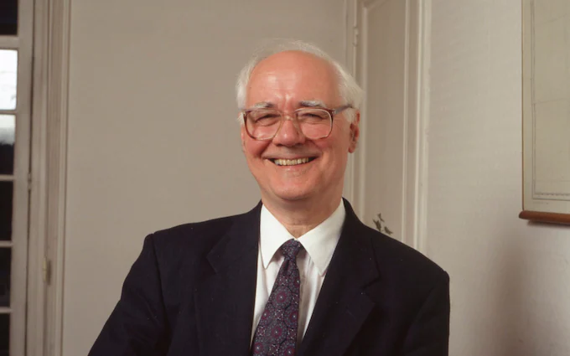
John Charlton Polkinghorne (16 October 1930 – 9 March 2021) was an English physicist, theologian, Cambridge lecturer and Anglican priest.

Slide 10
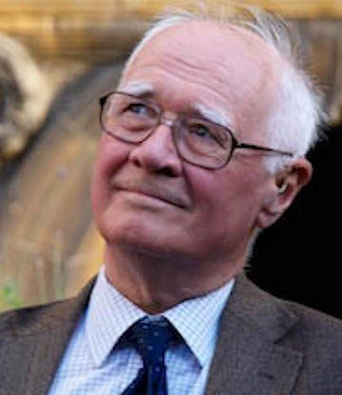
“When you realize that the laws of nature must be incredibly finely tuned to produce the universe we see, that conspires to plant the idea that the universe did not just happen, but that there must be a purpose behind it.”
The fine tuning of the universe cannot just be dismissed as a happy accident. (KU)

Slide 11
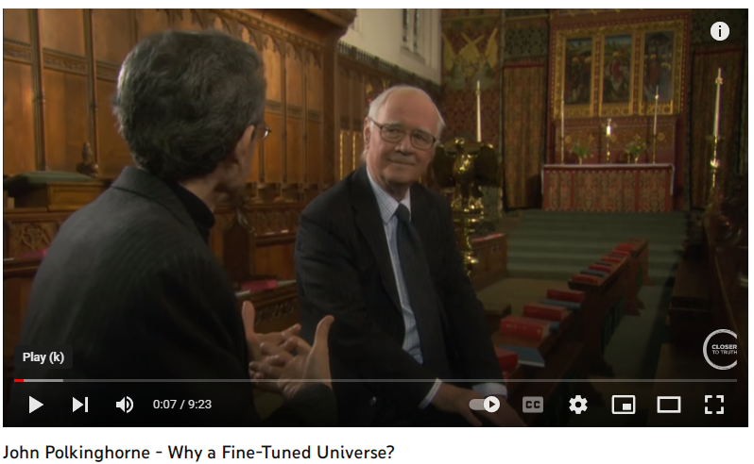
https://www.youtube.com/watch?v=6_rokY11zcg

Slide 12

Talking task:
The 3 men we have learnt about are:
Tennant
Brown
Polkinghorne
Choose one of them and explain their perspective on the teleological argument. Keep it nice and simple and make sure it makes sense to you.

Slide 13


Slide 14


Starter Task:
Tell each other about your weekend.
How would you describe it?
What was the highlight and what was the lowlight.

Slide 15

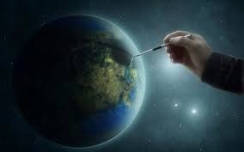
First task:
Summarise the teleological argument in a few sentences.
You must include the words:
Paley, watch, purpose, design and complex.

Slide 16

Paley uses an analogy to argue that the world is similar to a watch.
He says because both things are so complex, they could not have happened by chance, they must have been designed for a purpose.
He explains that this proves there is a God because in the same way as the watch has a designer so the earth must have a designer.

Slide 17
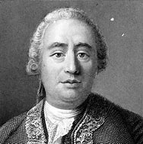
Hume's argument against the teleological theory
David Hume (1711-1776) was an agnostic at a time when atheist/agnostic writings were banned in many countries.
As an empiricist Hume was keen to show that the study of the natural world could not succeed in telling us anything of the Christian God.
It is important to remember that Hume predates Paley by 20-30 years. So Hume was not responding to Paley but rather the argument as outlined by thinkers such as Plato, Cicero and Aquinas.

Slide 18

Team game
You are going to work in four teams to discover Hume's 5 points.
A blue, yellow, green and pink team.
Around the room I have hidden 20 slips of paper. 5 are on blue, 5 are on yellow, 5 are on green and 5 are on pink..
Your task is to find all you teams slips of paper.
The first team to find them are the winners
You can’t help or hinder another team!

Slide 19

Read through each argument and discuss in your groups what each one means. Make sure you understand them.
Then rank them, with the argument you think is the strongest at the top and the one your group considers the weakest at the bottom.
Be clear about your reasons for this decision.
Lets hear from each others groups

Slide 20
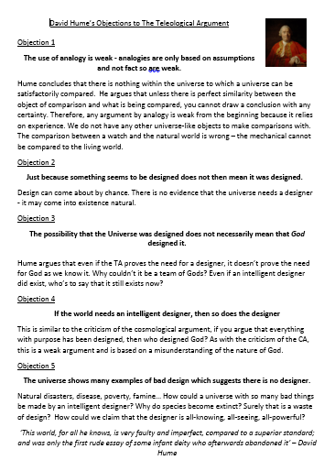
Lets read through his arguments in more depth.

Slide 21
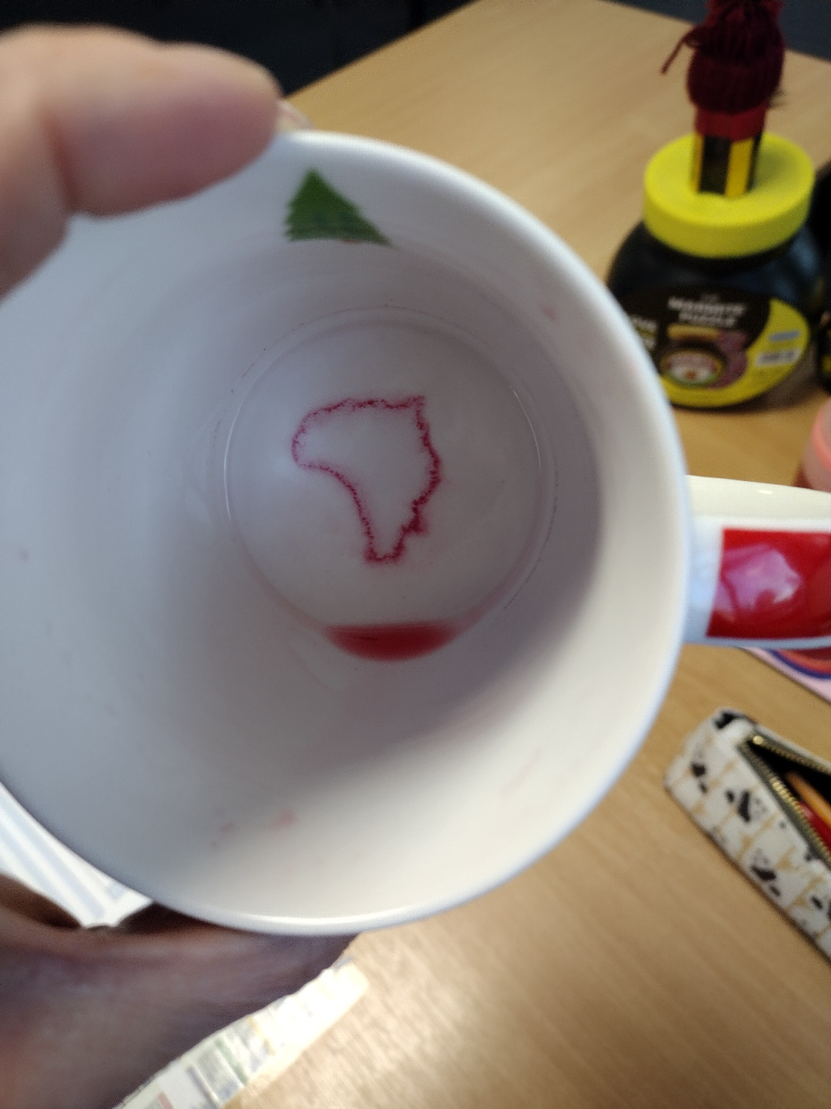

Slide 22
Written task:
Choose two of these objections that you find the easiest to understand and explain.
Write your own notes on each one.
Include KU, AN and try to add some EV. Meaning, try and explain whether or not you think this objection proves or disproves God’s existence.
You could start like this:
One objection Hume has about the teleological argument is……………………
What he means by this……………..
My opinion on this is…………………..

Slide 23

https://www.youtube.com/watch?v=7e9v_fsZB6A

